Slide 1
3rd session
2nd October 2018
1

Slide 2
  The SHORT TERM
Pugel, chap.18, 19
The Asset Market Approach to Foreign Exchange Rates
Most foreign exchange trades have a financial and not a commercial motive.
The asset market approach to foreign exchange rates emphasizes the role of the international investors. The price of a currency is the result of the combination of the demand and the offer of assets denominated in different currencies.
Capital Mobility
The interest rate parity indicates what to expect that happens to the foreign exchange rates in the short term.
The interest rate parity is a consequence of the interest rate arbitrage. Equilibrium condition of the financial markets.
2

Slide 3
Investment decision. In Lisbon, the interest rate is 6%. In NY, it is 8%. Where should one invest?
Foreign exchange risk.
If one wants to invest in a financial asset denominated in a foreign currency, one has to convert the initial value into the foreign currency, in order to buy the asset. The investment return will be denominated in the foreign currency needing conversion into the domestic currency, on a future moment.
What exchange rate is used to convert the foreign currency into the domestic currency, in the future?
If the forward foreign exchange rate is used, it is a covered international investment. If the future spot foreign exchange rate is used, it is an uncovered international investment
3

Slide 4
COVERED INTERNATIONAL INVESTMENT - Hedging
(The same type of analysis is used when someone borrows in the international market, instead of investing.)
Compare the alternative returns :
m.(1+i_{N}) and m.S(n/j).(1+i_{J}).F(j/n)
The covered interest differential = CD
(1+i_{J}).F(j/n)/S(j/n) – (1+i_{N})
IF CD>0, it is better to invest abroad (J).
IF CD<0, it is better to invest at home (N).
4

Slide 5
Define f (j/n) as [F(j/n) –S(j/n)] /S(j/n).
f is the premium. (Recall: IF f<0, j is at a discount and n is at a premium. IF f>0, j is at a premium and n at a discount.)
CD is approximately equal to f + (i_{J} –i_{N} ).
In order to be indifferent to invest in one country or in the other:
CD = 0 ⇔ F(j/n) /S(j/n) = (1+i_{N})/ (1+i_{J}) ⇔
F(j/n) /S(j/n) –1= (1+i_{N})/ (1+i_{J} ) –1 ⇔
f(j/n) = (1+i_{N})/ (1+i_{J} ) –1 ⇔
f(j/n) (1+i_{J} ) =i_{N} – i_{J}
5

Slide 6
Approximate COVERED INTEREST PARITY :
  f(j/n) =i_{N} – i_{J}
  CD>0 ⇔ f(j/n) > i_{N} – i_{J} ; CD<0 ⇔ f(j/n) < i_{N} – i_{J .}
The Covered Interest Arbitrage: Purchase a currency spot and sell it forward, profiting from the interest rate differential combined with the currency premium.
The Covered Interest Arbitrage leads to the Covered Interest Parity.
6

Slide 7
If interest parity does not exist, how is the equilibrium reestablished?
Suppose that (1+i_{J}).F(j/n)/S(j/n) – (1+i_{N}) > 0 and that it is best to borrow in N and invest in J.
  The demand for j and the supply of n, in the Spot foreign exchange market INCREASES
S(j/n) increases 
  The supply of j and the demand for n, in the Forward foreign exchange market INCREASES .
F(j/n) decreases 
In this analysis: interest rates as determinants of the foreign exchange rate in the Short Run.
7

Slide 8
There are no forward rates available for every currency, only for major international currencies. Additionally, an investor may wish to take the foreign exchange risk, either as a speculator or as a strategy of portfolio diversification.
UNCOVERED INTERNATIONAL INVESTMENT –
In this case, the future spot foreign exchange rate is used to convert the value of the international investment back into the original currency.
Similar to International Covered Investment, with S^{e}(j/n) instead of F(j/n).
8

Slide 9
The Expected Uncovered Differential = EUD :
(1+i_{J}). S^{e}(j/n) /S(j/n) – (1+i_{N}).
[S^{e}(j/n) –S(j/n)] /S(j/n) is not a premium but the expected appreciation rate of j.
UNCOVERED INTEREST PARITY:
  S^{e}(j/n)/S(j/n)= (1+i_{N})/ (1+i_{J}) .
  Equilibrium: Investment in the different currencies have the same expected rate of return.
In addition to the interest rates, also expectations are determinants of the foreign exchange rate in the Short Run.
9

Slide 10
The expectation of an appreciation of the currency of country J increases the attractiveness of current investments in that currency.
The relative demand for currency j in the FOREX increases. 
Currency j appreciates. 
In case of expectation of depreciation, the rationale is similar.
10

Slide 11
EXERCISE
If the 90 days interest rates i_{N} = 0,03 and i_{J} = 0,04, and the 90 days forward and the spot exchange rates are 2n per each j (f=0), how would arbitrage work?
11

Slide 12
  EXERCISE 8 from Pugel, p.440
  The following rates are available in the markets:
    Current spot exchange rate: $0.500/CHF
    Current 30-day forward exchange rate: $0.505/CHF
    Annualized interest rate on 30-day dollar-denominated bonds: 12% (1.0% for 30 days)
    Annualized interest rate on 30-day Swiss-franc-denominated bonds: 6% (0,5% for 30 days)
  Is the Swiss franc at a forward premium or discount?
  Should a US-based investor make a covered investment in Swiss franc-denominated bonds, rather than investing in 30-day dollar-denominated bonds? Explain.
  Because of covered interest arbitrage, what pressures are placed on the various rates? If the only rate that actually changes is the forward exchange rate, to what value will it be driven?
12

Slide 13
  EXERCISE 9 from Pugel, p.440
The following rates exist:
  Current spot exchange rate: $1.80/£
  Annualized interest rate on 90-day dollar-denominated bonds: 8% (2% for 90 days)
  Annualized interest rate on 90-day pound-denominated bonds: 12% (3% for 90 days)
  Financial investors expect the spot exchange rate to be $1.77/£ in 90 days.
  If he bases his decision solely on the difference in the expected rate of return, should a US based investor make na uncovered investment in pound-denominated bonds rather than investing in dollar-denominated bonds?
  If she bases her decision solely on the difference in the expected rate of return, should a UK based investor make na uncovered investment in dollar-denominated bonds rather than investing in pound-denominated bonds?
  If there is substantial uncovered investment seeking higher expected returns, what pressure is placed on the current spot exchange rate?
13

Slide 14
Empirical tests of the parity conditions
  Covered Interest Parity
    The premium must be approximately equal to the interest rate differential
    All variables are directly observable.
    Need to use compatible financial assets when comparing the interest rates (maturity and risk). For example, assets that are issued by the same institution but in different currencies so that the only risk is foreign exchange risk.
    Findings: without capital controls, parity tends to hold.
    Transactions cost, diﬀerential taxation across countries on the returns from investing in ﬁnancial markets, and political risk involved in investing in diﬀerent countries justify deviations from CIP. However, these deviations are small enough to assume that CIP holds true.

Slide 15
Transaction Costs
  Taking the case when it compensates to borrow in N to invest in J: (1+i_{J}).F(j/n)/S(j/n) – (1+i_{N}) > 0
  The arbitrageur borrows at i_{N}ª and invests at i_{J}^{b}
  Also, he purchases currency j spot at a foreign exchange rate S(j/n)ª, and sells it forward at F(j/n) ^{b}.
  This reduces profits.

Slide 16
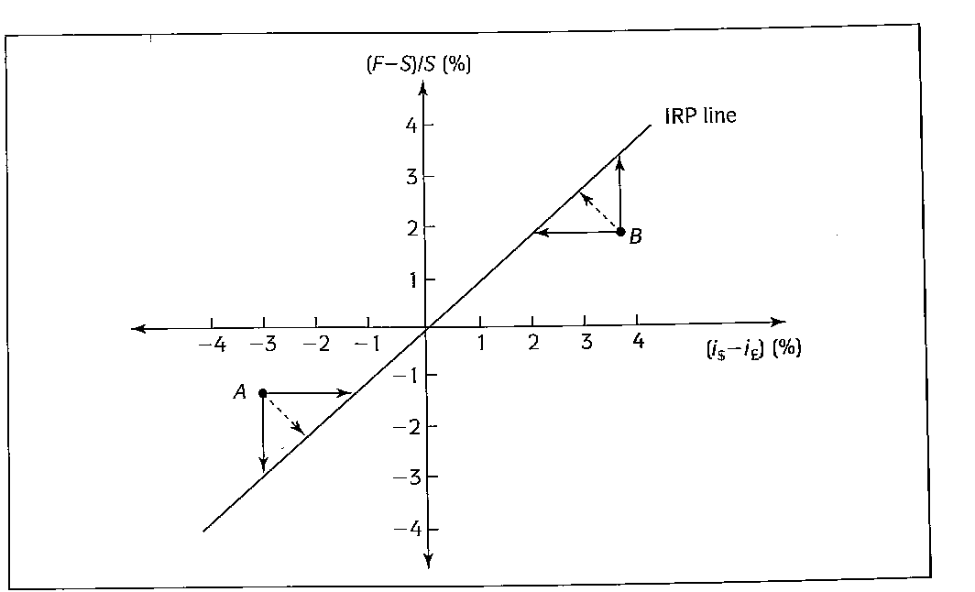

Slide 17
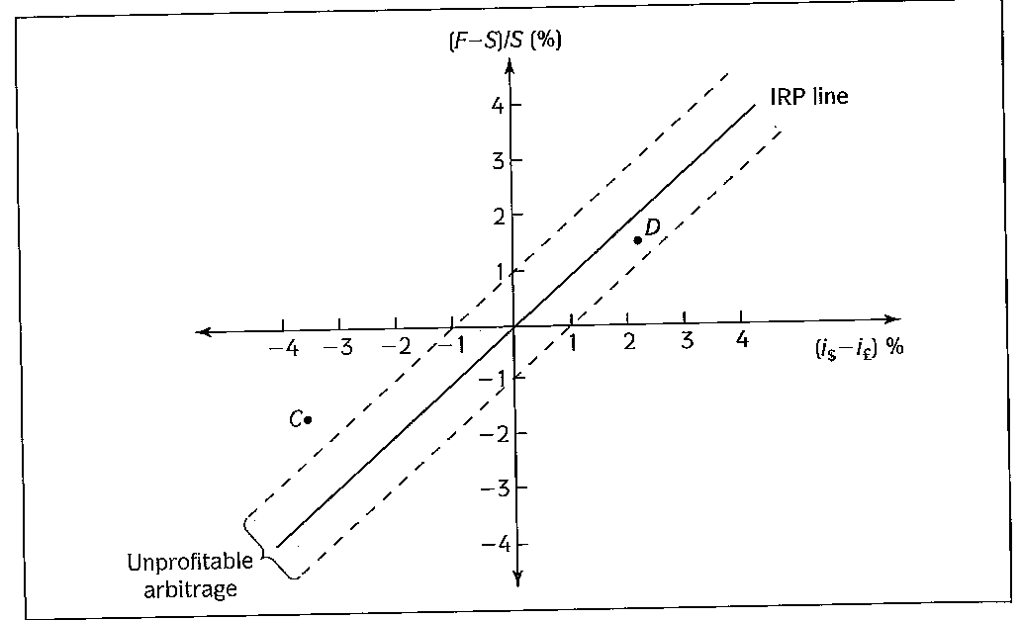


Slide 18
  Uncovered Interest Rate Parity
    The expected appreciation rate of the currency must be approximately equal to the interest rate differential.
    A higher interest rate in one country is compatible with an expected depreciation of that country’s currency.
    Not all the variables are directly observable: the expected foreign exchange rate.
    Solutions:
      Ask.
      Examine actual returns on uncovered international investments. If expected uncovered returns are usually (on average) at parity, over a large nr of investments the actual uncovered differentials should be approximately zero on average. Frequently, this is not found.

Slide 19
Studies - UIP does not hold in the data especially for the industrialized countries. Percentage change in expected future spot rate is not equal to interest diﬀerential.
  If the two parity conditions hold, then F_{t,t+h} = S^{e}_{t,t+h} .
  Explanations for deviations from UIP:
    Expectations Investors are systematically making mistakes in predicting the future value of spot exchange rate. Why especially over longer time periods do investors make big mistakes in a systematic fashion? Over time at least errors should shrink so that deviations from UIP became smaller.
    Risk aversion: there should be a premium to take a risk by not covering the investment. UIP takes into account only expected return.
      Uncovered Interest Differential = f(risk,riskaversion)

